Slide 1





Temporal Trends, Phenotypic And Molecular Characterization of Viral Respiratory Pathogens In Kenya: A multi- site surveillance study
Presenter: Annette Chesir
Supervisors: Dr. Athman Mwatondo, Dr. Robert Too
Kenya Field Epidemiology and Laboratory Training Program
Thematic Area : Epidemic and Pandemic Preparedness
Kenya Health Security Convention | 5th – 8th May 2026 | Mombasa - Kenya

Slide 2
Background 1/2
Viral respiratory infections cause a major challenge in global health systems
  Estimated burden 3—5million (Kenmoe et al, 2024)
  4th leading cause of death
  290,000 to 650,000 annual deaths attributed to influenza alone (Lafond, 2024)
  Top infectious cause of mortality in 2023(WHO,2024)
In Africa
  Highest burdens of viral respiratory pathogen-related mortality (Troeger et al., 2019)
  Most viral respiratory pathogens remained poorly monitored (Owusu et al., 2024)
In Kenya
  Influenza surveillance was initiated in 2006
  12 surveillance sites, 2 community-based in Asembo and Kibra, and 9 referral hospitals
NIC(National Influenza Centre) was established in 2014
  Receives samples from these 9 referral hospitals
  Study selected hospitals under NIC network

Slide 3
Background 2/2
Surveillance is conducted on symptomatic patients presenting
  influenza-like illness (ILI) and severe acute respiratory illness (SARI)
  Trained staff at sentinel sites collect & send Oropharigeal or Nasopharyngeal (OP/NP) specimens to NIC
WHO case definitions
  SARI-Acute respiratory illness +fever ≥38⁰C+ hospitalization
  ILI-Sudden onset of fever ≥38⁰C+cough/sore throat + no other diagnosis
Organisms of concern
  Influenza A, B, SARS-CoV2(Severe Acute Respiratory Syndrome Corona Virus 2), RSV(Respiratory Syncytial Virus), Human metapneumovirus (hMPV), rhinoviruses, & parainfluenza
  Extended SARI: records with results for Influenza A, B, SARS-CoV2 &RSV
The study analysed surveillance data with aim to enhance evidence-based clinical decision-making

Slide 4
Problem statement
Viral respiratory pathogens pose a significant global health challenge:
  Causes high morbidity & mortality in all age groups
  Easily transmitted within humans
  Able to cause local outbreaks & some linked to pandemic potential (WHO,2022)
Diagnostic Challenges in Low and Middle-income Countries(LMIC) like Kenya:
  Lack of rapid diagnostic tests
  Limited panel testing
  Long turnaround time delays treatment based on the results
  Empirical antibiotic prescription contributing to AMR (WHO,2022)
60% of hospital visits are due to respiratory illness
Approximately 30-40% have viral etiology (Troeger et al., 2019)
We lack multi-pathogen surveillance study

Slide 5
Objectives
Broad objective
To estimate the prevalence, molecular characterization, and risk factors of viral respiratory pathogen infection among patients with SARI or ILI in Kenya
Specific objectives
To estimate the prevalence of viral respiratory pathogens among the symptomatic patients
To determine the molecular characterization of these respiratory pathogens
To identify risk factors associated with infection with viral respiratory pathogens

Slide 6
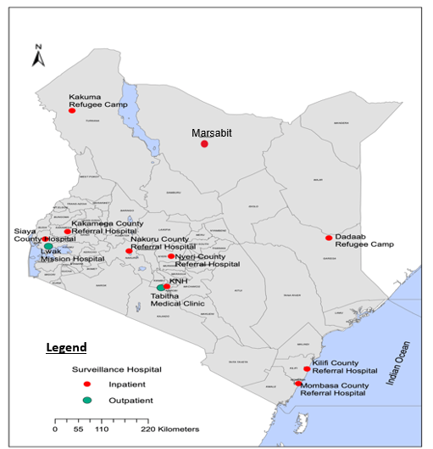
Methodology
Study design – cross-sectional analysis using 2019-2024 NIC network data
Study site: 9 sentinel sites under NIC network
  Sites distributed across Kenya's geographical, climatic & population dynamic zones
  7 Referral Centre's & 2 refugee camps
Study population: records of symptomatic patients visiting the surveillance sites
  SARI
  ILI
Sample size all eligible records

Slide 7
Results
27957 records NIC
932(3.3%)
27025
Positive 15.2%
Negative 84.8%
Mean age of 5.32 ± 12.38 years with a median age of 1.25 years and an age range of 0–84 years

Slide 8
Pathogen Detection Rates by Clinical Syndrome
Clinical syndrome | N=27025 | Positive (%)
SARI | 21467 | 2902(13.5%)
ILI | 5558 | 1208(21.7%)

Slide 9
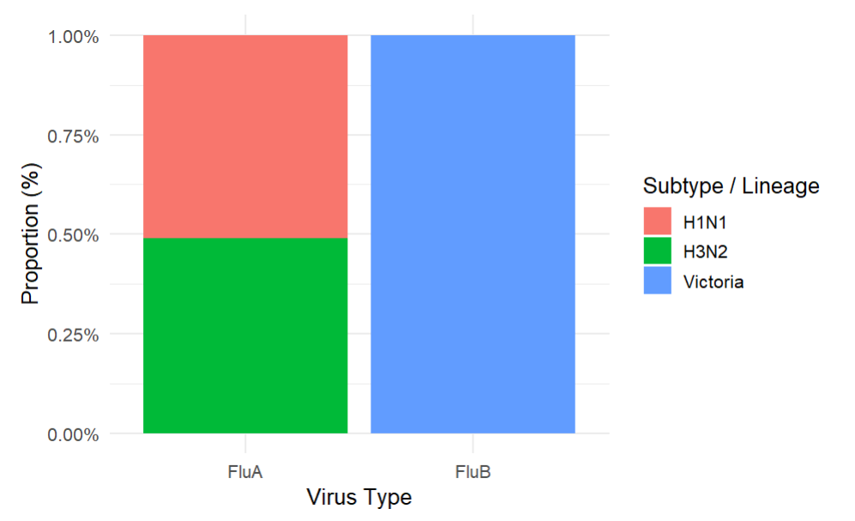
Molecular characterization

Slide 10
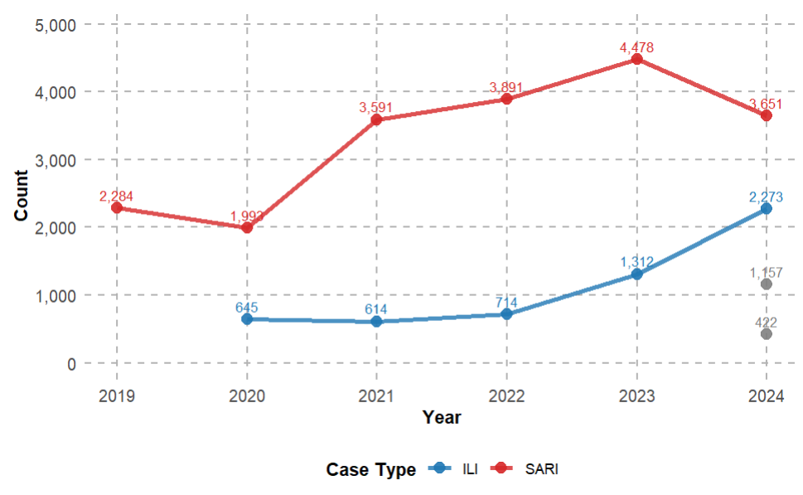
Annual trends SARI& ILI(2019-2024
  ILI increasing steadily from 2020 to 2024

Slide 11
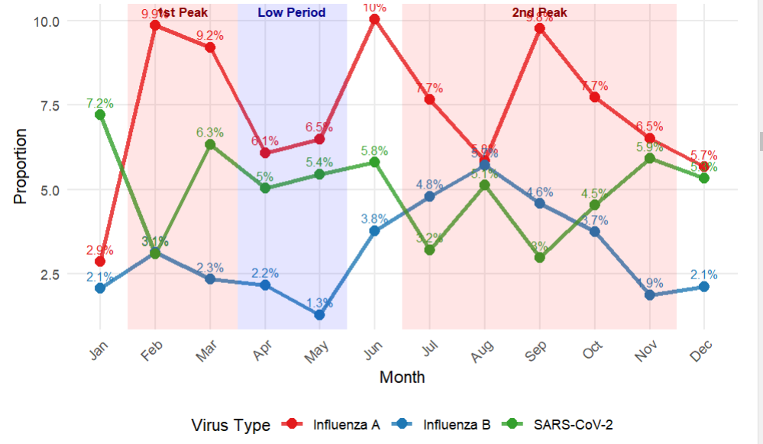
Seasonal patterns :monthly detection patterns
Notes:
Flu A First peak in February (9.9%) and a second peak in June (10%) and September (9.6%)

Slide 12
Risk factor analysis
Variable | Crude OR (95% CI) | Crude p-value | Adjusted OR (95% CI) | Adjusted p-value
Age Group (years)
<1 | 1.00 (Reference) | - | 1.00 (Reference) | -
1-4 | 1.45 (1.33-1.57) | <0.001 | 1.43 (1.32-1.55) | <0.001
5-14 | 1.83 (1.62-2.06) | <0.001 | 1.76 (1.55-1.99) | <0.001
15-24 | 1.72 (1.38-2.14) | <0.001 | 1.83 (1.45-2.30) | <0.001
25-49 | 2.82 (2.44-3.26) | <0.001 | 3.05 (2.59-3.60) | <0.001
≥50 | 2.40 (1.99-2.89) | <0.001 | 2.79 (2.28-3.40) | <0.001
Gender
Female | 1.00 (Reference) | - | 1.00 (Reference) | -
Male | 0.97 (0.91-1.04) | 0.404 | 1.02 (0.95-1.09) | 0.649
Case Type
ILI | 1.00 (Reference) | - | 1.00 (Reference) | -
SARI | 0.58 (0.54-0.63) | <0.001 | 0.68 (0.63-0.75) | <0.001
Sentinel Site
Dadaab | 1.00 (Reference) | - | 1.00 (Reference) | -
Kakuma | 1.35 (1.19-1.53) | <0.001 | 1.45 (1.27-1.65) | <0.001
Kakamega | 1.79 (1.47-2.17) | <0.001 | 1.58 (1.29-1.93) | <0.001
Kenyatta | 1.16 (0.99-1.35) | 0.064 | 1.32 (1.13-1.55) | <0.001
Mombasa | 1.10 (0.92-1.32) | 0.273 | 1.20 (1.00-1.43) | 0.054
Marsabit | 1.15 (0.93-1.41) | 0.193 | 0.65 (0.51-0.81) | <0.001
Nakuru | 1.57 (1.36-1.83) | <0.001 | 1.82 (1.56-2.12) | <0.001
Nyeri | 2.15 (1.87-2.49) | <0.001 | 1.66 (1.42-1.93) | <0.001
Siaya | 1.28 (1.11-1.48) | <0.001 | 0.93 (0.80-1.09) | 0.374

Slide 13
Discussion
Overall prevalence was 15.2%
  Falls within the range reported in other African influenza surveillance programs
  Lower than in high-income countries
  Broader diagnostic testing is performed(Grunberg et al., 2021)
Kenyan molecular characterization near co-circulation of influenza subtypes and exclusive dominance of Victoria lineage
  Align closely with patterns reported across sub-Saharan Africa
  South Africa has reported concurrent circulation of H1N1 and H3N2 subtypes with alternating dominance in specific years (Davids et al., 2024)
Adults aged 25–49 years had >3X the odds of infection compared to children <1 (aOR = 3.05)
  consistent with data from South Africa
  Adults were found to have higher odds of influenza positivity than young children despite children being the most frequently tested (Rha et al., 2019)

Slide 14
Discussion
Influenza A demonstrated two major peaks
  First peak in February (9.9%) and a second peak in June (10%) and September (9.6%)
  Aligns with a study done by Emukule et al, 2016
Kakuma refugee camp had the highest burden of SARI cases
  Population dynamics
Positivity varied widely across sentinel sites, ranging from 12.7% in Dadaab to 21.7% in Nyeri
  documented in influenza surveillance across Africa
  often attributed to climatic factors, population density, and healthcare access (Emukule, et al., 2019)

Slide 15
Conclusion
Viral respiratory pathogens accounted for a substantial proportion
  SARI
  ILI cases in Kenya
Predominant pathogen was influenza A
  SARS-CoV-2
  influenza B
Prevalence rates were lower than those reported in comparable East African studies
Molecular characterization revealed:
  Balanced co-circulation of influenza A subtypes
  Exclusive detection of influenza B Victoria lineage
Distinct seasonal patterns that differed markedly between pathogens
  Bimodal peak influenza A
The majority of respiratory illness presentations lack confirmed viral aetiology

Slide 16
Policy Impact and Implications
  Expand testing panel to include major respiratory viruses not currently tested
    Currently testing four
  Establish molecular monitoring programs for all the tested panels
    Currently monitoring Influenza A and B
  Do vaccination campaigns immediately before high peak months and in context with molecular characterization findings
  Managements of patients should be based on diagnosis not empirical antimicrobial prescription
  Share data to antimicrobial stewardship

Slide 17

Thank you!
Scan to visit our website
#KeHSCon2026
@NPHIKenya
www.nphi.go.ke

